Slide 1
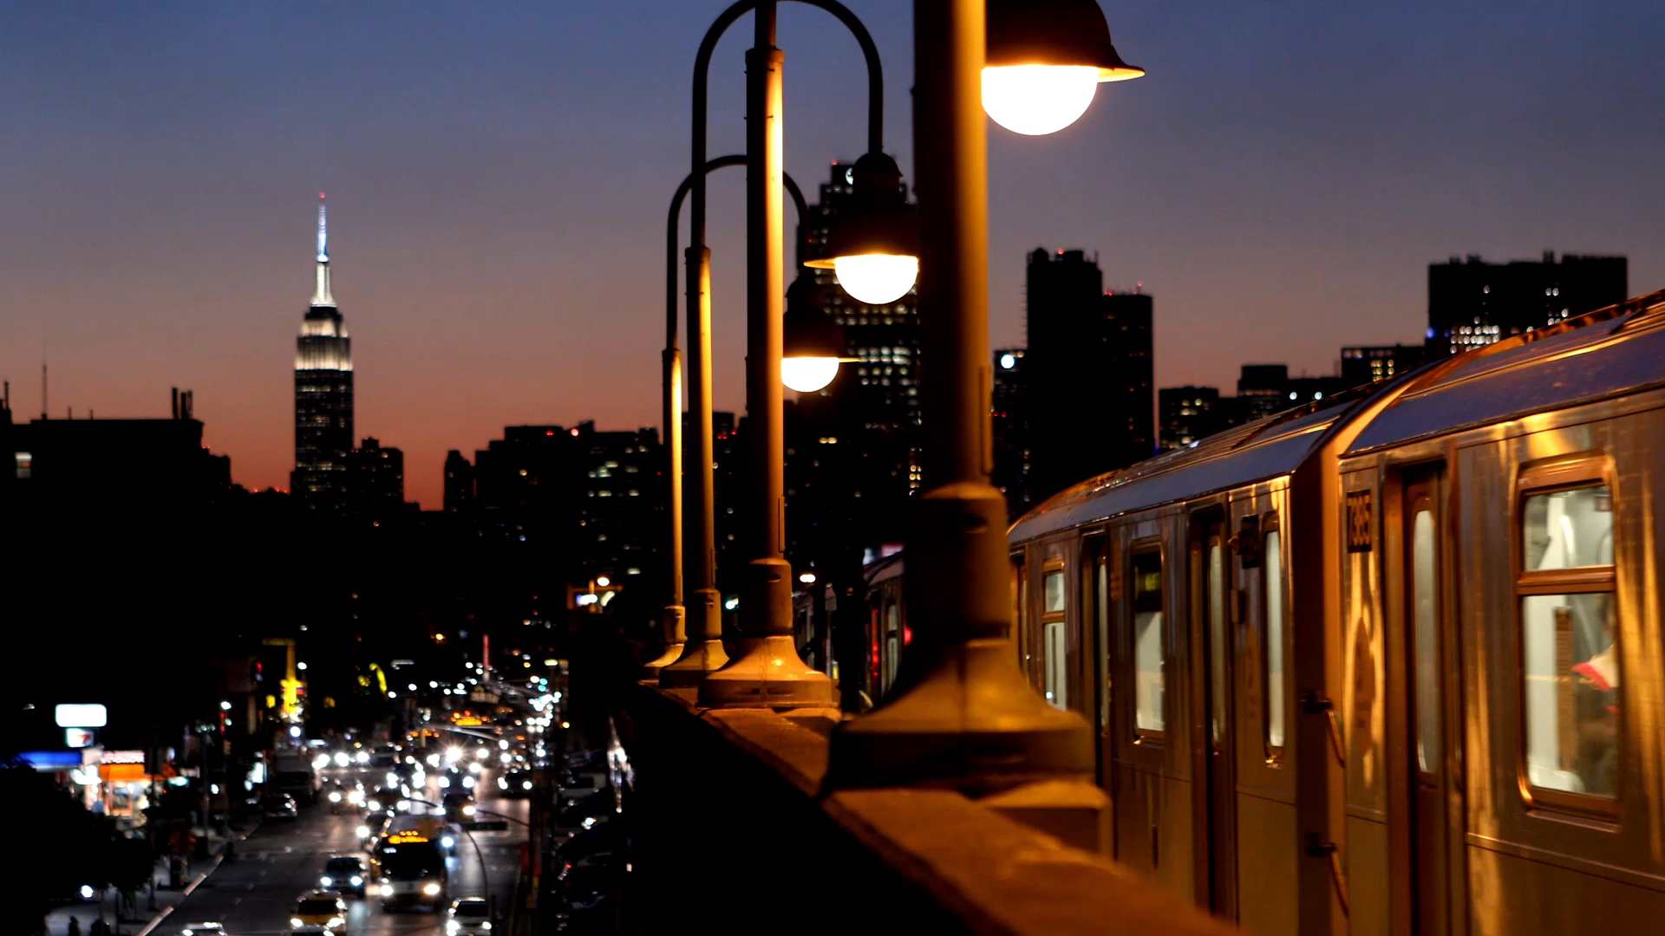
DAA SEMINAR BASED ON M – COLOURING
GROUP MEMBERS :
U19CS001 : PARVA SHAILESHKUMAR PATEL
U19CS025 : JINIL JIGARKUMAR THAKKAR
U19CS026 : SUMEET SANJAY KAMBLE
U19CS030 : YASH MAHESHBHAI PATEL

Slide 2
Problem Statement
You are given a undirected graph.
Now colour each vertices using maximum M colours such that no two adjacent
vertices have same colour .
INPUT
First line of input consist of an integer N denoting number of vertices.
Second line of input consist of an integer M denoting number of colours that can be used to colour.
Third line of input consist of an integer E denoting number of Edges.
The next E lines each contain two space-separated integers u and v ( denoting undirected edge
between vertices u and v ) .
OUTPUT
If Coloring is Possible : then Print “ Solution Does Exist”.
Also , Print the Colour Order in the Order of Vertex i.e C1 C2 C3 …
If Colouring is not possible using M colours : then Print “ Solution Does Not Exist” || return False.

Slide 3
We will solving the given problem using three algorithms:
Namely:
1.) Simple Recurrison
2.) Backtracking
3.) Using BFS (Breadth – First – Search )
To Understand the Working of Algorithm , Let us take an Example :
10
3
15
2
1 3
6
7
8
4
9
5
8
6
5 7
10
9
10
10

Slide 4
Approach 1 : Simple Recurrision
Assumptions :
Here , only 3 colours since M = 3 .
White color as colourless / un-coloured = 0
Red colour = 1
Blue colour = 2
Orange colour = 3
A colour Array with nos. of elements = nos. of vertices = N (here = 10)
Say C[10] , and Initializing all elements with 0 ( i.e colourless )
C = { 0 , 0 , 0 , 0 , 0 , 0 , 0 , 0 , 0 , 0 };
Graph[n][n] is a binary matrix , in which if Graph[i][j] = 1 it denotes edge between
I and J and 0 means no edge .

Slide 5
1
Approach 1 : Simple Recurrision
Algorithm :
We will iterate (i) from vertex 1 to N ( i.e. 10)
And recursively colour next vertices with
C [ i ] + 1
Until we reach till I = N (last vertex)
And then check if the graph is
Safe or Not ,
If the graph is not safe
We will exit current recurrision
And go back to previous recurrision
And set C [ i ] + 1
This is the Given Graph acc. to Input
7
2
4
8
6
3
10
9
5

Slide 6
Depth of recursion
C = { 0 , 0 , 0 , 0 , 0 , 0 , 0 , 0 , 0 , 0 }
= 1
1
= 2
Intially :
All Vertices Colourless = 0
(for representation white)
= 0
Depth of recursion = 0
Now ,
we will start iterating
Through vertices using ‘i’ as
An iterator and
We will colour all
Vertices with its next color
Until we reach I = N
represents current
vertex
= 3
7
2
4
8
6
3
10
9
5

Slide 7
Depth of recursion
C = { 1 , 0 , 0 , 0 , 0 , 0 , 0 , 0 , 0 , 0 }
= 1
1
i = 0
= 2
1st vertex will be coloured
= 3
7
2
4
8
6
3
10
9
5

Slide 8
Depth of recursion
C = { 1 , 1 , 0 , 0 , 0 , 0 , 0 , 0 , 0 , 0 }
= 1
1
i = 1
= 2
Now ,
2nd vertex will be coloured red
= 3
i = 0
7
2
4
8
6
3
10
9
5

Slide 9
Depth of recursion
C = { 1 , 1 , 1 , 0 , 0 , 0 , 0 , 0 , 0 , 0 }
= 1
1
i = 2
= 2
Now ,
3rd vertex will be coloured red
= 3
i = 1
i = 0
7
2
4
8
6
3
10
9
5

Slide 10
Depth of recursion
C = { 1 , 1 , 1 , 1 , 0 , 0 , 0 , 0 , 0 , 0 }
= 1
1
i = 3
= 2
Now ,
4th vertex will be coloured red
= 3
i = 2
i = 1
7
i = 0
2
4
8
6
3
10
5
9

Slide 11
Depth of recursion
C = { 1 , 1 , 1 , 1 , 1 , 0 , 0 , 0 , 0 , 0 }
= 1
1
i = 4
= 2
Now ,
5th vertex will be coloured red
= 3
i = 3
i = 2
7
i = 1
i = 0
2
4
8
6
3
10
5
9

Slide 12
Depth of recursion
C = { 1 , 1 , 1 , 1 , 1 , 1 , 0 , 0 , 0 , 0 }
= 1
1
i = 5
= 2
Now ,
6th vertex will be coloured red
= 3
i = 4
i = 3
7
i = 2
i = 1
2
4
8
i = 0
6
3
10
5
9

Slide 13
Depth of recursion
C = { 1 , 1 , 1 , 1 , 1 , 1 , 1 , 0 , 0 , 0 }
= 1
1
i = 6
= 2
Now ,
7th vertex will be coloured red
= 3
i = 5
i = 4
7
i = 3
i = 2
2
4
8
i = 1
6
i = 0
3
10
5
9

Slide 14
Depth of recursion
C = { 1 , 1 , 1 , 1 , 1 , 1 , 1 , 1 , 0 , 0 }
= 1
1
i = 7
= 2
i = 6
Now ,
8th vertex will be coloured red
= 3
i = 5
7
i = 4
i = 3
2
4
i = 2
8
6
i = 1
i = 0
3
10
5
9

Slide 15
Depth of recursion
C = { 1 , 1 , 1 , 1 , 1 , 1 , 1 , 1 , 1 , 0 }
= 1
1
i = 8
= 2
Now ,
9th vertex will be coloured red
= 3
i = 7
i = 6
7
i = 5
i = 4
2
4
i = 3
8
6
i = 2
i = 1
3
10
i = 0
5
9

Slide 16
Depth of recursion
C = { 1 , 1 , 1 , 1 , 1 , 1 , 1 , 1 , 1 , 1 }
= 1
1
i = 9
= 2
Now ,
10th vertex will be coloured red
= 3
i = 8
i = 7
7
i = 6
i = 5
2
4
i = 4
8
6
i = 3
i = 2
3
10
i = 1
i = 0
5
9

Slide 17
Depth of recursion
C = { 1 , 1 , 1 , 1 , 1 , 1 , 1 , 1 , 1 , 1 }
= 1
1
i = 10
= 2
Now ,
Since i = 10 = N
We will check whether the Coloured Graph
is safe or not .
In this case it isn’t safe since adjacent
Vertices are red i.e 1
So , we return false and go back in
Recursion to update the
Colours.
= 3
i = 9
NOT SAFE
i = 8
7
i = 7
i = 6
2
4
i = 5
8
6
i = 4
i = 3
3
10
i = 2
i = 1
i = 0
5
9

Slide 18
Depth of recursion
C = { 1 , 1 , 1 , 1 , 1 , 1 , 1 , 1 , 1 , 0 }
= 1
1
i = 9
= 2
Now ,
10th vertex will become colourless
= 3
i = 8
i = 7
7
i = 6
i = 5
2
4
8
i = 4
6
i = 3
i = 2
3
10
i = 1
i = 0
5
9

Slide 19
Depth of recursion
C = { 1 , 1 , 1 , 1 , 1 , 1 , 1 , 1 , 1 , 2 }
= 1
1
i = 9
= 2
Now ,
10th vertex will be coloured blue
That is the next colour (2)
= 3
i = 8
i = 7
7
i = 6
i = 5
2
4
i = 4
8
6
i = 3
i = 2
3
10
i = 1
i = 0
5
9

Slide 20
Depth of recursion
C = { 1 , 1 , 1 , 1 , 1 , 1 , 1 , 1 , 1 , 2 }
= 1
1
i = 10
= 2
Now ,
Since i = 10 = N
We will check whether the Coloured Graph
is safe or not .
In this case it isn’t safe since adjacent
Vertices are red i.e 1
So , we return false and go back in
Recursion to update the
Colours.
= 3
i = 9
NOT SAFE
i = 8
7
i = 7
i = 6
2
4
i = 5
8
6
i = 4
i = 3
3
10
i = 2
i = 1
i = 0
5
9

Slide 21
Depth of recursion
C = { 1 , 1 , 1 , 1 , 1 , 1 , 1 , 1 , 1 , 0 }
= 1
1
i = 9
= 2
Now ,
10th vertex will become colourless
= 3
i = 8
i = 7
7
i = 6
i = 5
2
4
8
i = 4
6
i = 3
i = 2
3
10
i = 1
i = 0
5
9

Slide 22
Depth of recursion
C = { 1 , 1 , 1 , 1 , 1 , 1 , 1 , 1 , 1 , 3 }
= 1
1
i = 9
= 2
Now ,
10th vertex will become orange
i.e next colour
= 3
i = 8
i = 7
7
i = 6
i = 5
2
4
8
i = 4
6
i = 3
i = 2
3
10
i = 1
i = 0
5
9

Slide 23
Depth of recursion
C = { 1 , 1 , 1 , 1 , 1 , 1 , 1 , 1 , 1 , 3 }
= 1
1
i = 10
= 2
Now ,
Since i = 10 = N
We will check whether the Coloured Graph
is safe or not .
In this case it isn’t safe since adjacent
Vertices are red i.e 1
So , we return false and go back in
Recursion to update the
Colours.
= 3
i = 9
NOT SAFE
i = 8
7
i = 7
i = 6
2
4
i = 5
8
6
i = 4
i = 3
3
10
i = 2
i = 1
i = 0
5
9

Slide 24
Depth of recursion
C = { 1 , 1 , 1 , 1 , 1 , 1 , 1 , 1 , 1 , 0 }
= 1
1
i = 9
= 2
Now ,
10th vertex will become colourless
i.e white
As well as the for loop will end
Hence returning false and exiting the
Topmost recursion
= 3
i = 8
i = 7
7
i = 6
i = 5
2
4
8
i = 4
6
i = 3
i = 2
3
10
i = 1
i = 0
5
9

Slide 25
Depth of recursion
C = { 1 , 1 , 1 , 1 , 1 , 1 , 1 , 1 , 2 , 0 }
= 1
1
i = 8
= 2
Now ,
Similarly 9th vertex will be coloured blue
i.e the next colour and then white
and so on & so forth we will find the
The solution by exiting and calling function
Recursively and colouring resp vertices
And Printing once the graph is safe
= 3
i = 7
i = 6
7
i = 5
i = 4
2
4
8
i = 3
6
i = 2
i = 1
3
10
i = 0
5
9

Slide 26
This Process will happen until we get a safe graph :
I.E 3¹⁰ times .
Till then it will recursively colour , de - colour to get a right graph.
Since we cant show each and every recursion these are some of the intermediates steps of Colour Array
C = { 1 1 1 1 1 1 1 1 2 0 } C = { 1 1 1 1 1 1 1 2 1 0 }
C = { 1 1 1 1 1 1 1 1 2 1 } C = { 1 1 1 1 1 1 1 2 1 1 }
C = { 1 1 1 1 1 1 1 1 2 0 } C = { 1 1 1 1 1 1 1 2 1 0 }
C = { 1 1 1 1 1 1 1 1 2 2 } C = { 1 1 1 1 1 1 1 2 1 2 }
C = { 1 1 1 1 1 1 1 1 2 0 } C = { 1 1 1 1 1 1 1 2 1 0 }
C = { 1 1 1 1 1 1 1 1 2 3 } C = { 1 1 1 1 1 1 1 2 1 3 }
C = { 1 1 1 1 1 1 1 1 2 0 } C = { 1 1 1 1 1 1 1 2 1 0 }
C = { 1 1 1 1 1 1 1 1 0 0 } C = { 1 1 1 1 1 1 1 2 0 0 }
C = { 1 1 1 1 1 1 1 1 3 0 } C = { 1 1 1 1 1 1 1 2 2 0 }
C = { 1 1 1 1 1 1 1 1 3 1 } C = { 1 1 1 1 1 1 1 2 2 1 }
C = { 1 1 1 1 1 1 1 1 3 0 } C = { 1 1 1 1 1 1 1 2 2 0 }
C = { 1 1 1 1 1 1 1 1 3 2 } C = { 1 1 1 1 1 1 1 2 2 2 }
C = { 1 1 1 1 1 1 1 1 3 0 } C = { 1 1 1 1 1 1 1 2 2 0 }
C = { 1 1 1 1 1 1 1 1 3 3 } C = { 1 1 1 1 1 1 1 2 2 3 }
C = { 1 1 1 1 1 1 1 1 3 0 } C = { 1 1 1 1 1 1 1 2 2 0 }
C = { 1 1 1 1 1 1 1 1 0 0 } C = { 1 1 1 1 1 1 1 2 0 0 }
C = { 1 1 1 1 1 1 1 0 0 0 } …
C = { 1 1 1 1 1 1 1 2 0 0 } And So on …until we get a perefectly coloured graph

Slide 27
= 1
1
Finally :
Depth of recursion = 0
= 2
= 3
Final Colour Order of Vertices :
C = { 1 , 2 , 2 , 1 , 2 , 3 , 3 , 3 , 1 , 1 }
In Simpler Terms , This Algorithm is an Brute Force Approach which tries all possible combination i.e 3¹⁰
(in this case) As seen in previous slide .
And print the right / safely m – coloured graph or returns Not Possible if it isn’t
Possible
7
2
4
8
6
3
10
9
5

